Slide 1

GOAL HACKERS
Akansha Khatuwala -RBA_004
Bhakti Andurkar - RBA_017
Anant Kalamkar - PG_064
Anuja Biyani- RBA_011
Ruchit Makwana- RBA_045

Slide 2
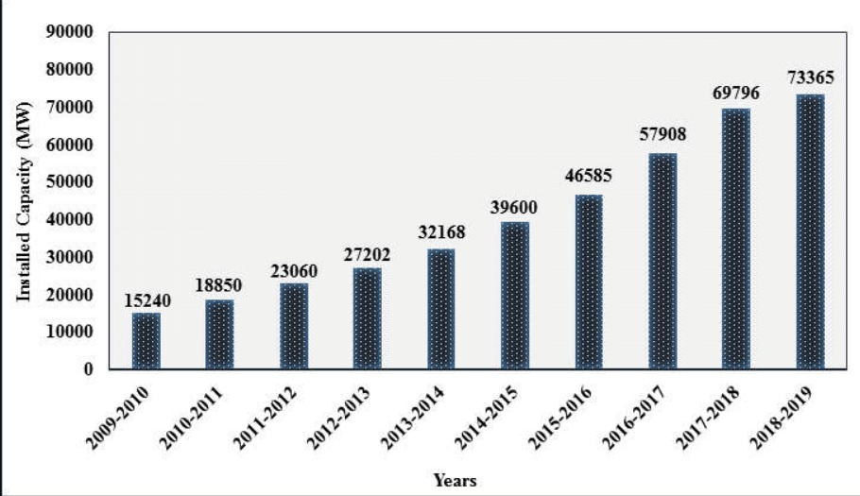
PROBLEM STATEMENT
Understanding power consumption in Indian states
Electricity consumption in Indian homes has tripled since 2000. The percentage of households with access to electricity has increased from 55% in 2001 to more than 80% in 2017.
To understand the trend in consumption of power in India, we have analyzed consumption based on two factors:
Macro (Socioeconomic)
Micro(Direct use)

Slide 3
METHODOLOGY
We have collected electricity consumption data of the Indian states from 2010 to 2021 and examined the usage of maximum power consumption.
Maharashtra was at top of the list for consumption of electricity in India. Hence, we focused on this state and analyzed the dependency of electricity consumption on macro and micro economic factors.
We have used python programming language to calculate the multiple linear regression and calculated the most important factors on which electricity consumption depends.
Then we used correlation test between market penetration for the top ten consuming electrical appliances and significant factors which we got through regression model.

Slide 4
DEPENDENCY FACTORS
Macroeconomic Factor | Microeconomic Factor
Per capita GDP(GDPt) Electricity price(Pt) Unemployment rate(UnEmpt) | We have considered the top ten high electricity-consuming appliances and analyzed the consumption of the electrical appliances popularly utilized in households.​

Slide 5
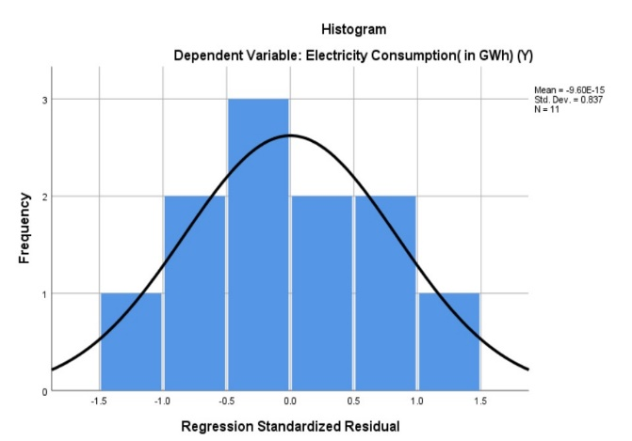
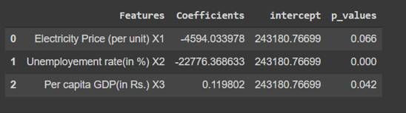
DETAILED WORKING
The equation formed using variables described in previous slide for REGRESSION MODEL : Et =α0 + α1GDPt + α2Pt + α3UnEmpt​
Considering the output of the regression model, we have rejected the Null hypothesis.
P-value of the variables Per capita GDP and Unemployment rate is less than 0.05, so these are significant, so electricity consumption is dependent on them with 95% confidence level.
We can use this model with 90% confidence level considering all these variables.
Analysing the data from 2010 to 2021 of the Macro economic variables, we found these are normally distributed and we could use them for the hypothesis testing.

Slide 6
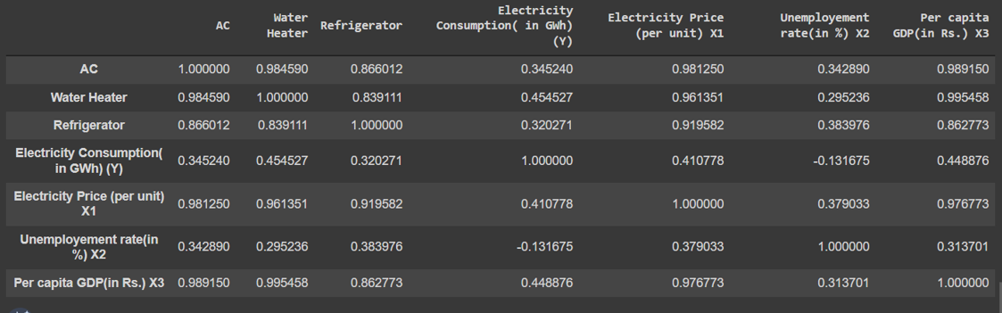
DETAILED WORKING
CORRELATION MODEL:-
We are good to consider these two factors for the correlation with top 3 electricity consuming appliances.
We have analysed the output of the correlation so that we can concentrate on the factors which are highly impacting electricity consumption

Slide 7
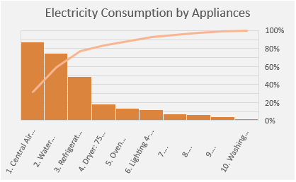
SOLUTION OVERVIEW
We have combined the outputs of correlation and regression model to determine the variables and appliances that should be prioritized.
We have concluded that Per capita GDP and Employment rate highly affects the power consumption.
AC, Refrigerators, and Water heaters are the top 3 electricity consuming appliances that should be prioritized.

Slide 8
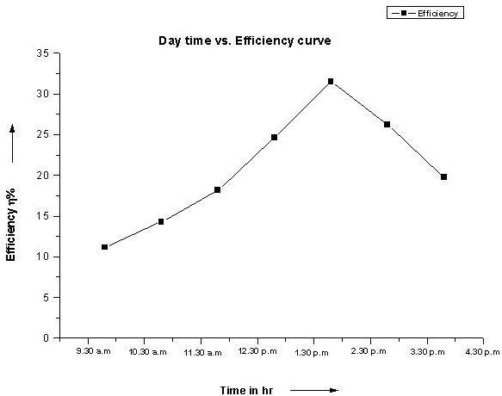
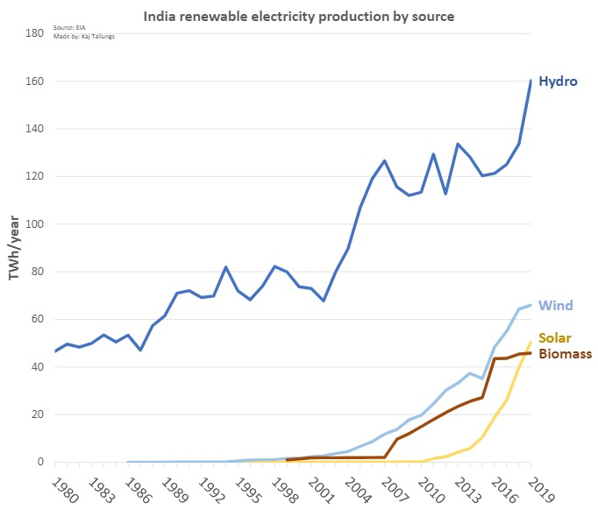
UNIQUENESS OF SOLUTION
The top 3 appliances that consume the maximum electric power should have a sensor installed in them so that when such appliances are not in use gets automatically switched off to save electricity.
The state government should utilize more renewable energy sources to generate power rather than non-renewable sources of energy.
Time has indirect relation with the efficiency of the appliances, hence the Govt. should also introduce "Policy of Appliance Disposal" to minimize the consumption of electricity.

Slide 9
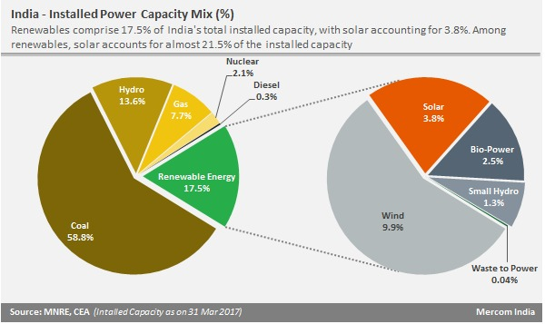
THE WAY AHEAD
We can reduce the electricity consumption by focusing more on renewable sources of energy like production of electricity through solar, hydro and wind energy.

